Slide 1
INFO6105 DSEM FINAL PROJECT CNN & NLP NORTHEASTERN UNIVERSITY
AAKASH BHATT - 002791277
AISHWARYA KATKAR - 002961534
MAKARAND ZENDE - 002772931

Slide 2
TABLE OF CONTENTS
PROBLEM STATEMENT – DEEP LEARNING
PROBLEM STATEMENT - NLP
01
04
02
ABOUT CNN
05
ABOUT NLP
APPROACH AND RESULTS - CNN
APPROACH AND RESULTS - NLP
03
06

Slide 3

PART 1:
DEEP LEARNING

Slide 4
PROBLEM STATEMENT
Build two deep models using the Faces-Age-Classification Dataset to predict the classification of Age

Slide 5

PROBLEM STATEMENT
DEEP LEARNING
Build two deep models using the Faces-Age-Classification Dataset to predict the classification of Age

Slide 6
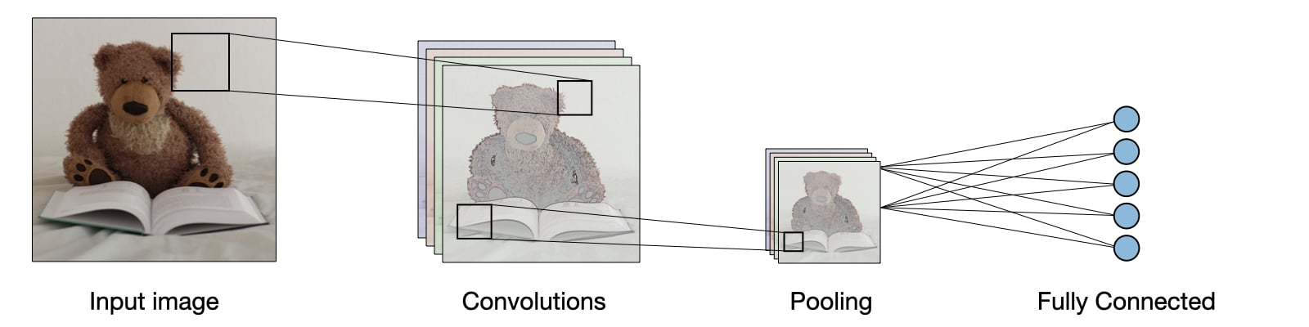
ABOUT CONVOLUTIONAL NEURAL NETWORKS
Convolutional neural networks are distinguished from other neural networks by their superior performance with image, speech, or audio signal inputs. They have three main types of layers, which are:
Convolutional layer
Pooling layer
Fully-connected (FC) layer

Slide 7
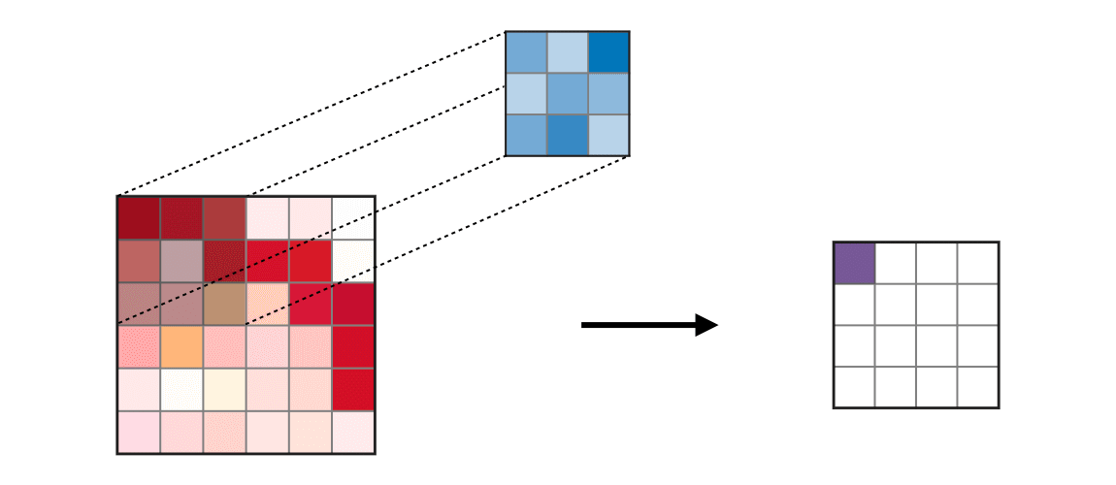
CONVOLUTION LAYER (CONV)
A convolutional layer is a key component of a convolutional neural network (CNN).
The convolution layer (CONV) uses filters that perform convolution operations as it is scanning the input with respect to its dimensions. Its hyperparameters include the filter size F and stride S. The resulting output O is called a feature map or activation map.
With each layer, the CNN increases in its complexity, identifying greater portions of the image. Earlier layers focus on simple features, such as colors and edges. As the image data progresses through the layers of the CNN, it starts to recognize larger elements or shapes of the object until it finally identifies the intended object.

Slide 8
POOLING (POOL)
Pooling layers, also known as down sampling, conduct dimensionality reduction, reducing the number of parameters in the input
Similar to the convolutional layer, the pooling operation sweeps a filter across the entire input, but the difference is that this filter does not have any weights. Instead, the kernel applies an aggregation function to the values within the receptive field, populating the output array.
While a lot of information is lost in the pooling layer, it also has a number of benefits to CNN. They help to reduce complexity, improve efficiency, and limit the risk of overfitting.
Type | Max pooling | Average pooling
Purpose | Each pooling operation selects the maximum value of the current view | Each pooling operation averages the values of the current view
Comments | • Preserves detected features • Most commonly used | • Downsamples feature map • Used in LeNet

Slide 9
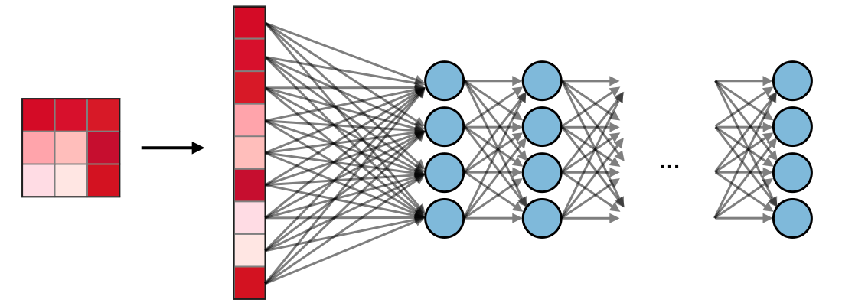
FULLY CONNECTED (FC)
The fully connected layer (FC) operates on a flattened input where each input is connected to all neurons. If present, FC layers are usually found towards the end of CNN architectures and can be used to optimize objectives such as class scores.

Slide 10
READING AND PROCESSING THE DATASET
Unzip images in our dataset
Reading our dataset for analyzing classes
Converting our class column to numerical
Resizing images to same size 512*512 using function
Selecting and applying labels to images based on class

Slide 11
BUILDING OUR MODEL
Splitting our dataset into train and test - image
Autotuning of both train and test data
Initializing our deep learning model with image input size, no of classes, and imagenet for image classification
Compiled our model using Adam optimizer
Used SparseCategoricalCrossEntropy for computing cross-entropy loss
Evaluated model performance by changing the number of epochs
Compared our model accuracy to the pre-trained ResNet model

Slide 12
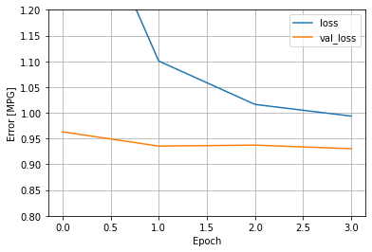
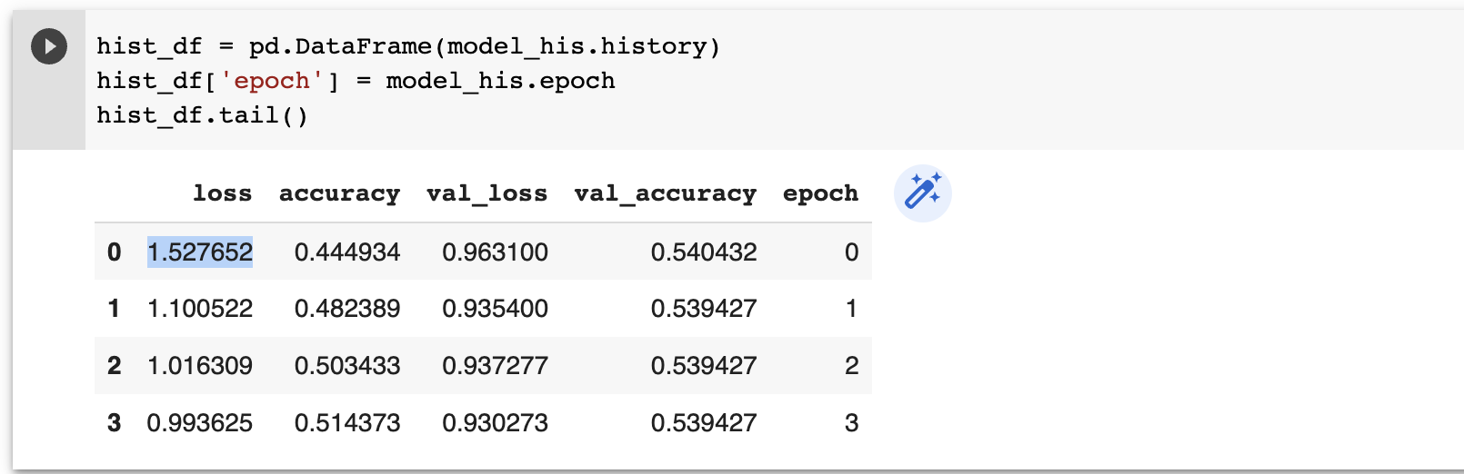
RESULTS

Slide 13
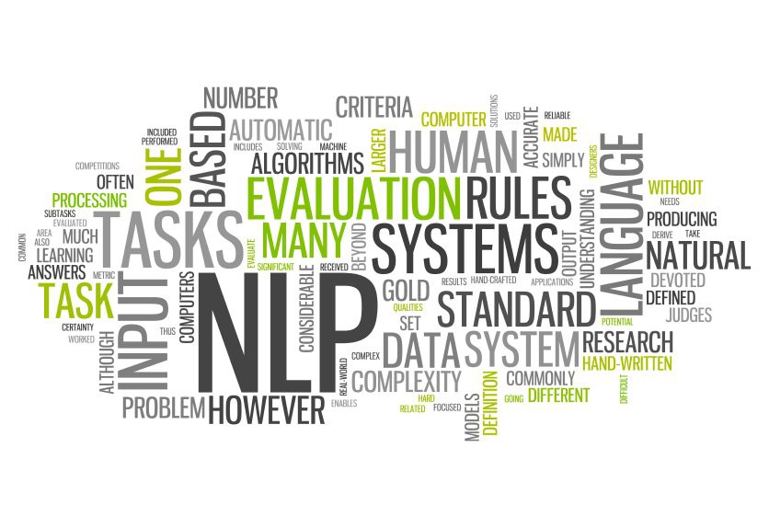
PART 2:
Natural Language Processing

Slide 14
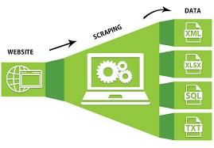
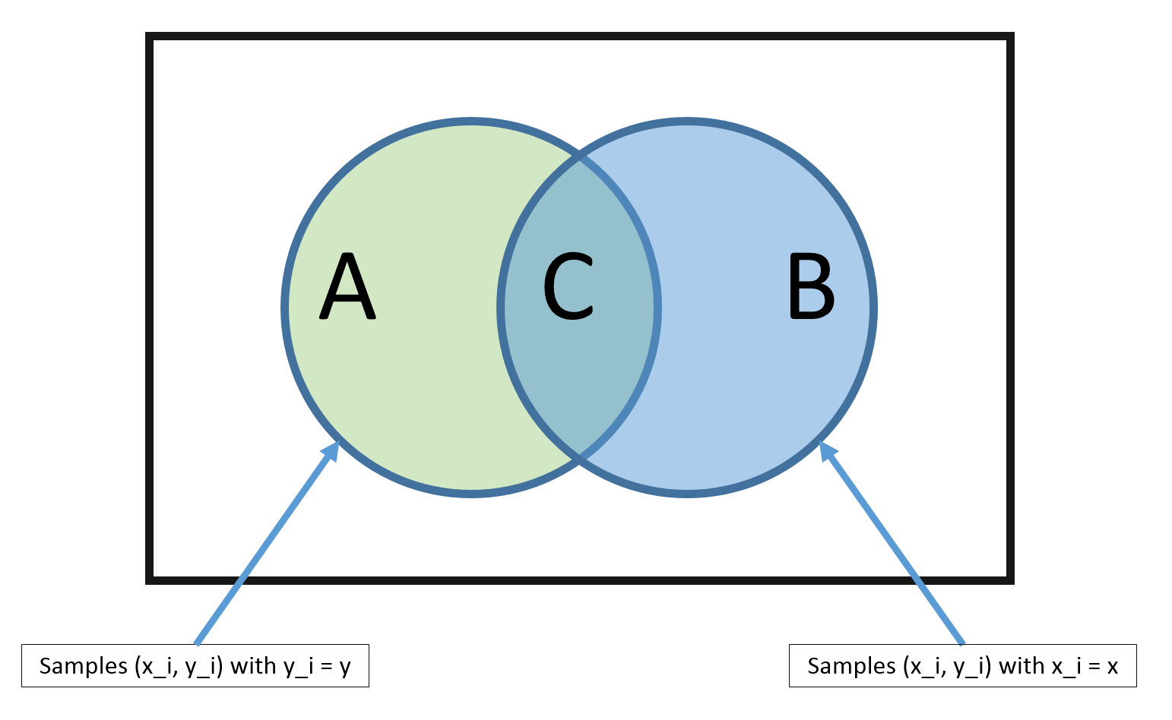
PROBLEM STATEMENT
SCRAPING & NLP
NAÏVE BAYES CLASSIFIER
Scrape about 5000 reviews on any one Amazon product of choice.
The product we chose -
Alexa - Echo dot 3rd Gen
Considering reviews with 1-2 as 'negative' and 4-5 as 'positive', develop an NBC classifier.

Slide 15
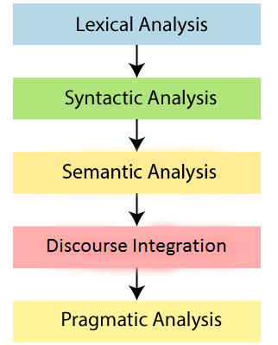
ABOUT NLP
NLP comes to use when there are enormous amounts of text data which is present in an unstructured format
Reading text, comprehending speech, and correctly formatting interpretations
To extract precise or practical insights from text, NLP is crucial
Given are the phases of NLP

Slide 16



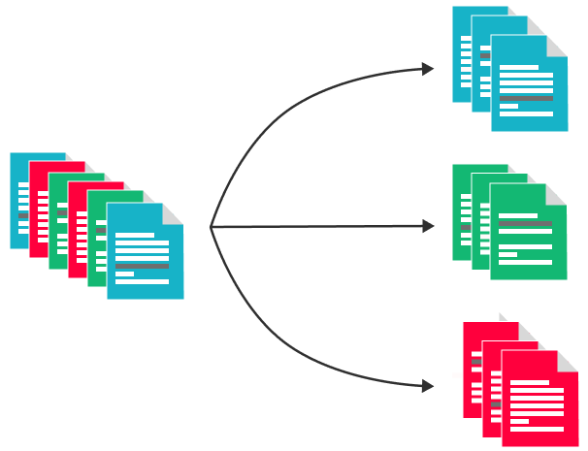


STEPS PERFOMED
SCRAPE DATA
DATA FORMATING
SENTIMENT COLUMN
STOPWORDS, STEMMING, LEMMATIZATION
BUILD DATA MODEL
OUTPUT
Used BeautifulSoup library in python to perform the scraping
Formatted some scraped variables to bring them in required format
Based on ratings created Sentiment column having 3 classes Positive Negative and Neutral
Build Naïve Bayes classifier using review column in x and sentiment column in y
Predicted results using test dataset
Performed NLP steps on Review column

Slide 17
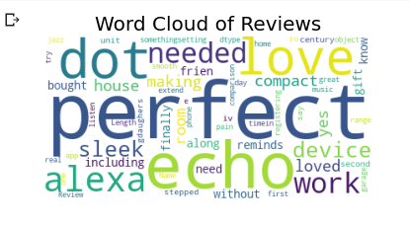
WORDCLOUD

Slide 18
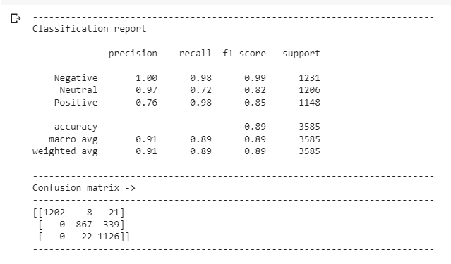
RESULTS - NLP

Slide 19
CONCLUSION
Model | Training Accuracy | Validation Accuracy
Model built from Scratch Using MobileNetV2 | 51.43% | 53.94%
Model built using RESNET50 | 41.58% | 54.14%
Model - NLP | Accuracy
Bernoulli Naïve Bayes | 89.12%

